Slide 1
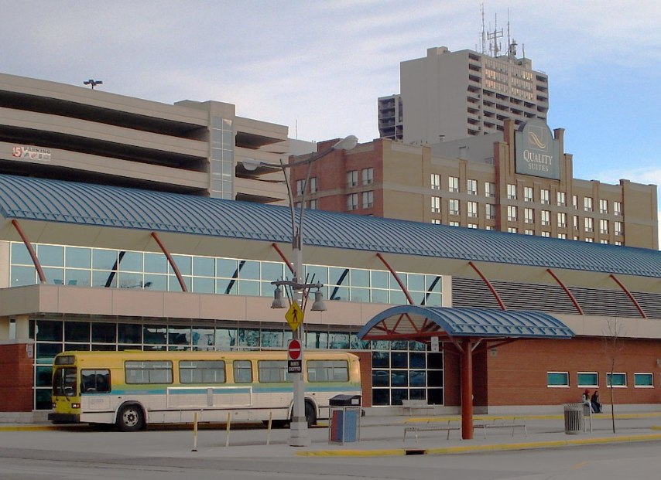

Transit Windsor
Streamlining operations and improve coordination

Slide 2
Table of Contents
1. Problem Statement
2. Summary
3. Goals
4. Risk and Issues
5. Data and Metrics
6. Results
7. Dashboard
8. Timeline
9. Budget
10. Future Work
11. Conclusion

Slide 3
Our Team (III)
Krupali
Mewada
Shubham
Sihag
Abhishek
Rana
Ramandeep
Chauhan

Slide 4
Problem Statement
Our focus is on addressing the difficulties presented by high levels of traffic, large numbers of passengers, and limited availability in Windsor's transportation network.
Our initiative includes investigating, examining, and organizing strategies to create a more effective and dependable transit system.

Slide 5
Summary
Our team has partnered with Transit Windsor to introduce intelligent transit technologies, such as a machine learning algorithm, to tackle traffic and overcapacity issues.
We conducted a comprehensive evaluation to determine the feasibility and potential outcomes of our suggestions.
Our dedication to discovering inventive and data-supported resolutions demonstrates our resolve to make a long-lasting difference in the transportation sector.

Slide 6
Objectives
The goal of our project is to improve the dependability and effectiveness of Transit Windsor by addressing the issues of traffic and overcrowding.
We have suggested solutions, such as intelligent transportation systems, that aim to improve routes, decrease wait times, and enhance passenger satisfaction.
Our primary objectives are to establish a dependable and effective transportation service that satisfies the needs of commuters and supports the growth of the community.

Slide 7
SWOT Analysis
Strength:
Provide essential transportation to the community
Weakness:
Limited Routes and frequency of service to the community
Opportunities:
The potential to introduce new technologies and solutions that can enhance the transit experience for riders
Threats:
Increased competition from other transportation providers

Slide 8
Milestones
Problem Statement:
Transit Windsor aimed to enhance transportation efficiency
Data Gathering:
Data collection from Transit Windsor and Prof. John
Data Assessment:
Data Assessment was done for further improvements and enhancements
Data Merged:
The merged data enabled the identification of valuable insights for improving the transit system.
Model Selection:
Implementing different ML algorithms to improve accuracy and select the most appropriate one.
Dashboard:
Creation of dashboard for visual representation of data.

Slide 9
Risk & Issues
Unanticipated technical or logistical problems could result in delays or exceed the budget during the implementation of the new technology.
The project's effectiveness could be influenced if Transit Windsor personnel and customers are unable to quickly adopt the new technology.
The initiative requires major modifications to the current transit system, which could lead to opposition or hesitation from employees and customers.

Slide 10

Data & Metrics

Slide 11
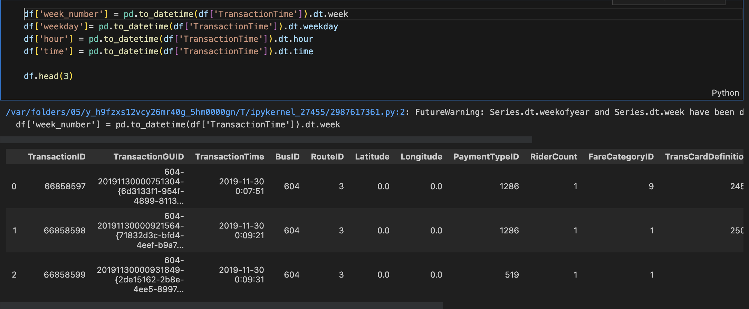
Feature Engineering

Slide 12
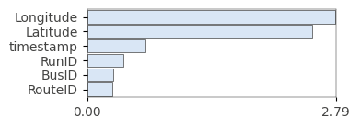
Feature Importance Plot

Slide 13

Results

Slide 14
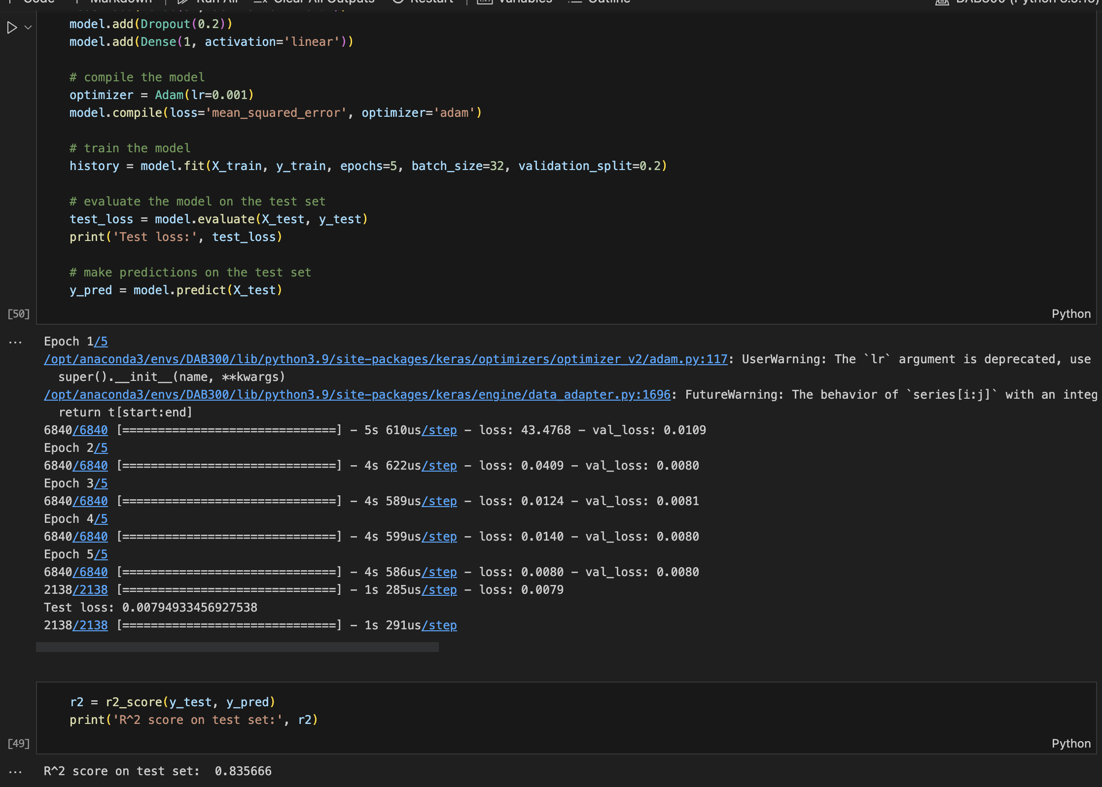
Model Selection

Slide 15
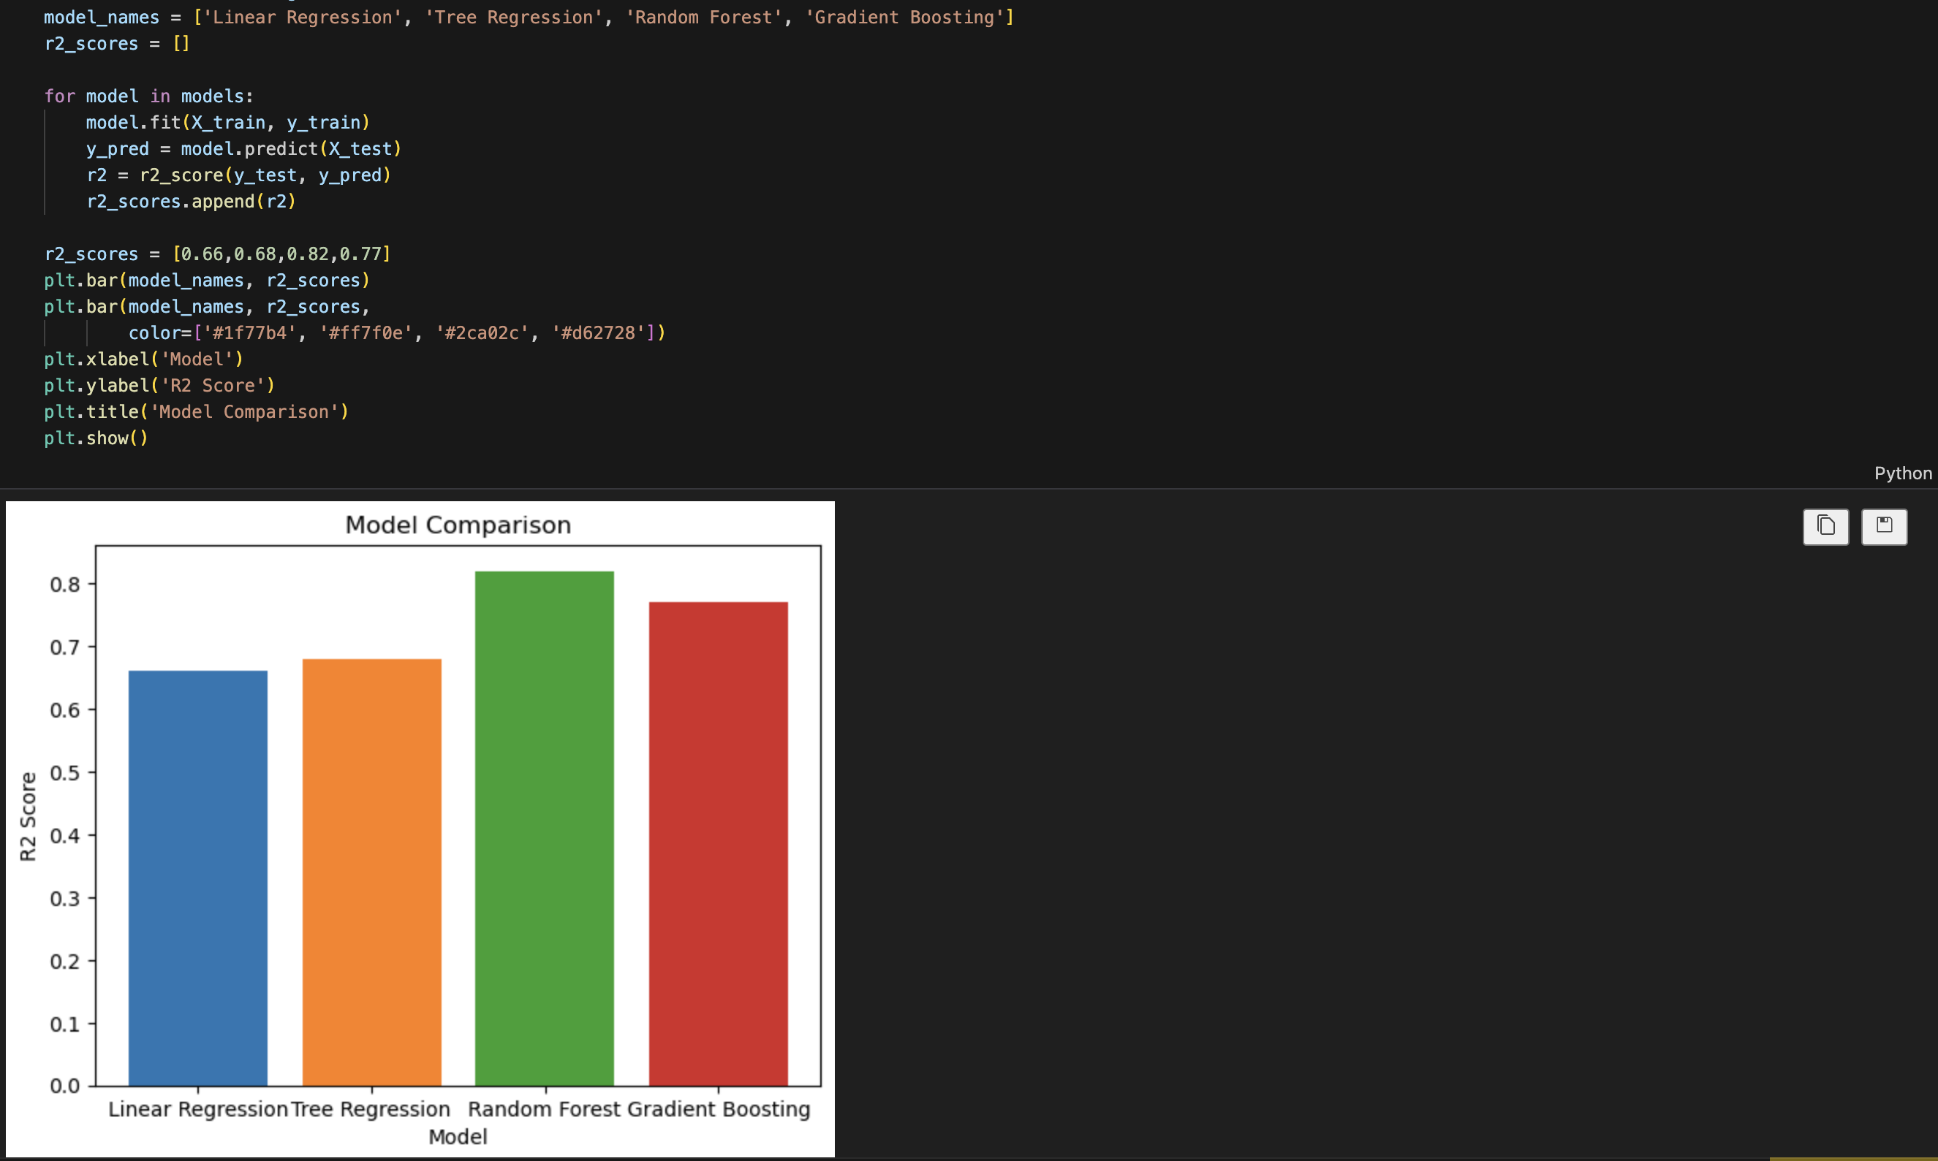
Model Comparison

Slide 16
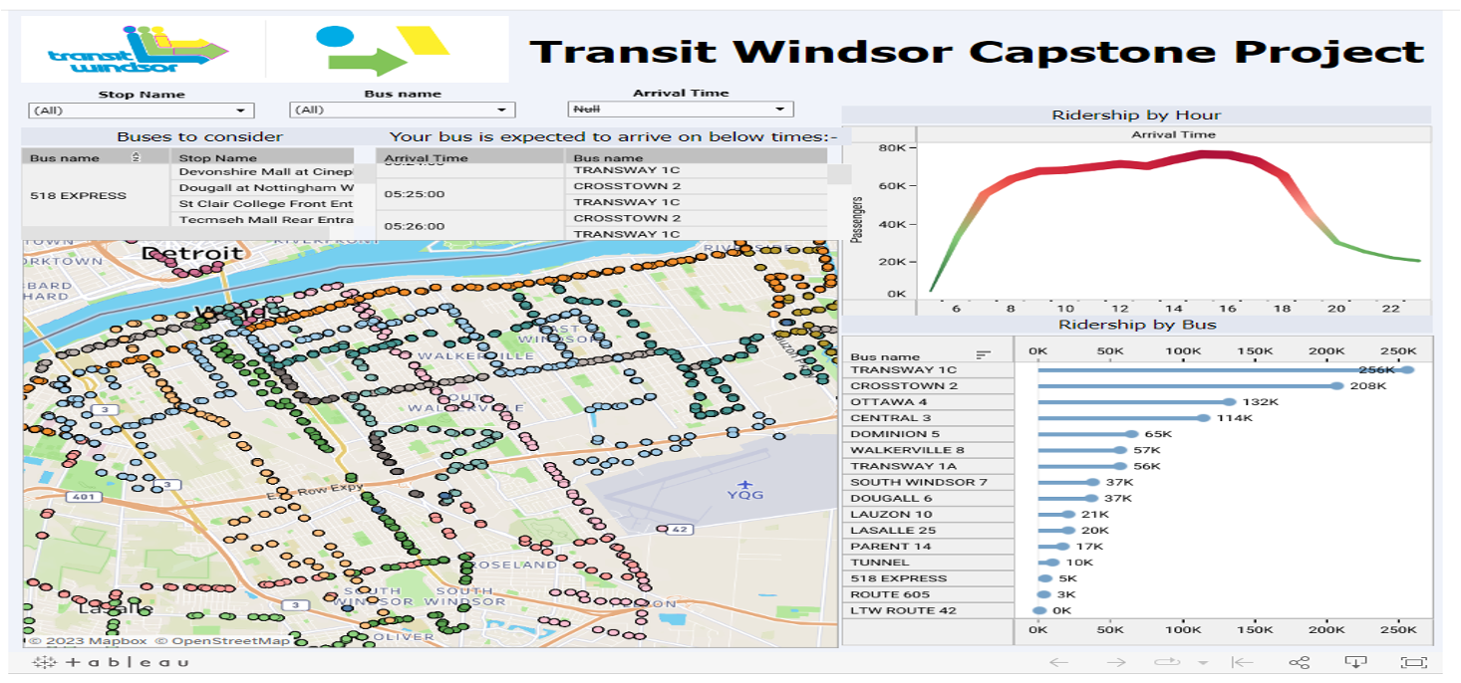
Dashboard
https://public.tableau.com/app/profile/abhishek.rana6106/viz/TransitWindsorCapstoneProject/Dashboard1?publish=yes

Slide 17
Tableau Dashboard
We have created a Tableau dashboard that is easy to use and suitable for a broad range of individuals, including data analysts and business leaders.
The dashboard is equipped with various filters and drill-down options that enable users to explore the data in more detail and personalize the display based on their requirements.
Our aim is to offer valuable insights through this dashboard and promote data-driven decision-making within our organization.

Slide 18
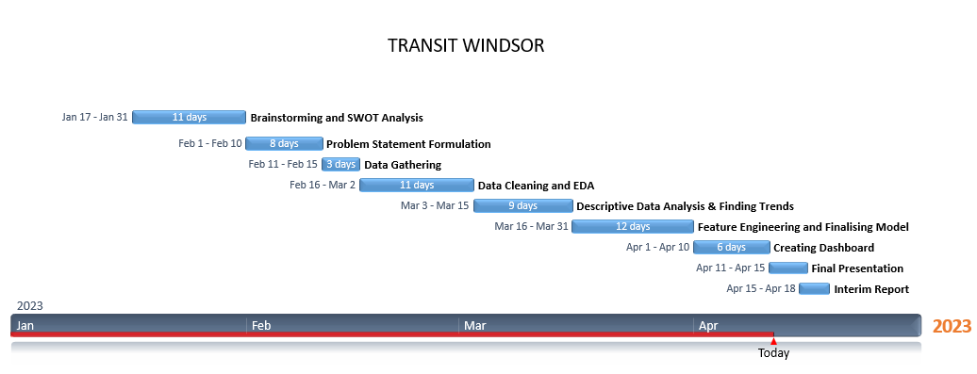
Timeline

Slide 19
Budget

Slide 20
Cost
Resources | Cost
Mobile Application | 70,000 CAD
Hardware (GPS and Others) | 15,000 CAD
Database | 20,000 CAD
Training | 15,000 CAD
Technical Support | 9,000 CAD
Testing | 18,000 CAD
Total: 147,000 CAD

Slide 21
Future Work
Enhancing Collaborations: Our plan is to build stronger partnerships with various transit agencies, businesses, and organizations. By doing so, we can establish more cohesive transportation alternatives and offer passengers more complete services.
Expansion Strategy: Following the integration of Windsor Transit within Windsor-Essex county, we would aim to broaden our reach to other municipalities that face comparable transportation requirements.
LSTM Model: Implementation of this model to improve accuracy.

Slide 22
Conclusion
The Transit Windsor initiative has made significant progress in various areas such as data collection and integration, selecting the appropriate ML models, and feature engineering.
However, there are some challenges and concerns that require attention, such as implementation hurdles, user acceptance, and data protection.
With proper planning and execution, the project can accomplish its objective of revitalizing and enhancing the transportation system for its patrons.

Slide 23
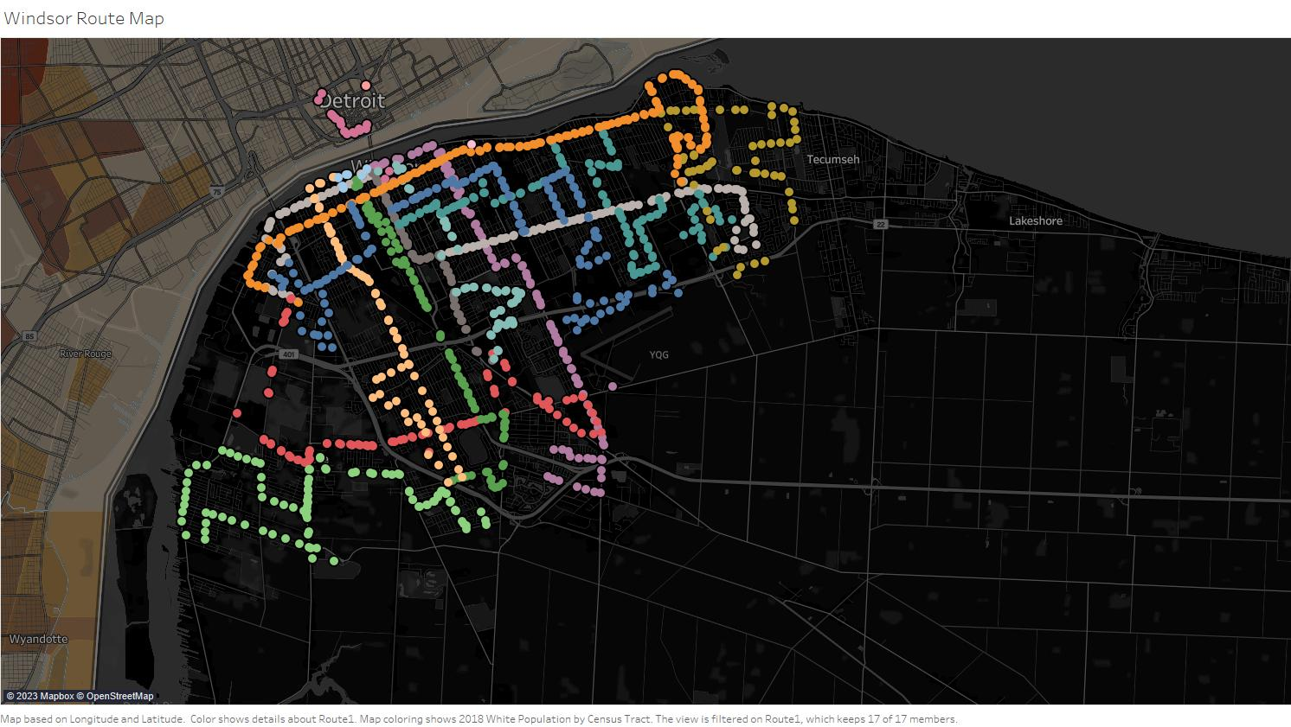
Thank You
https://shubham-sihag.github.io/Transit-Windsor/

